Slide 1
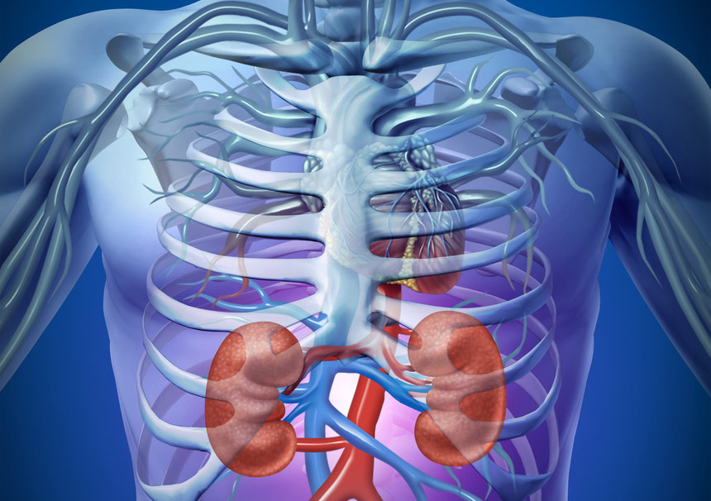
Hypertetion and CKD
By
Prof. Ali Taha Alkoriaty
Professor of internal medicine and nephrology
Head of internal medicine department
Suhag faculty of medicine

Slide 2
Agenda
Introduction
Evaluation of HTN patients and CKD
Goals of Antihypertensive Therapy in CKD
Dietary and lifestyle modifications
Pharmacological therapy
HTN in kidney transplant recipients
HTN in elderly with CKD
Home message

Slide 3

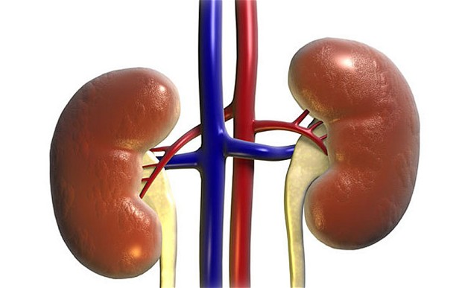
Introduction Relation of HTN&CKD
Both CKD and HTN can cause or aggravate the other
Hypertension is the second leading causes of ESRD after Diabetes
In fact, more patients develop HTN from CKD
CKD and HTN increase the risk of CVD & stroke by 22% compared to equally hypertensive individuals without CKD

Slide 4
Effect of blood pressure on kidney disease :
Hypertensive nephrosclerosis
The most characteristic microscopic lesion is hyalinosis of afferent arterioles that cause glomerular ischemia and in some areas, interstitial fibrosis and tubular atrophy
In other cases glomerular hypertrophy occur, that would favor the development of proteinuria and disease progression

Slide 5
Effect of kidney disease on blood pressure
Sodium retention
Increased activity of the renin-angiotensin system
Enhanced activity of the sympathetic nervous system
Secondary hyperparathyroidism raises the intracellular calcium concentration, which can lead to vasoconstriction and hypertension
Hypertension may occur or be exacerbated in patients with advanced chronic kidney disease treated with epo
Impaired NO synthesis and endothelium-mediated vasodilatation has been demonstrated in patients with uremia.

Slide 6
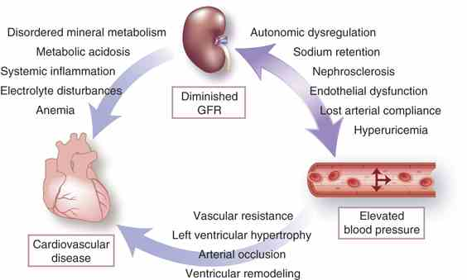

Slide 7

Evaluation of patients with HTN as regard presence of CKD

Slide 8
Evaluation of HTN patients as regard presence of CKD
objectives of the evaluation are
detection of identifiable causes of hypertension
assessment of target organ damage, including CKD
identification of other CVD risk factors or concomitant disorders that may define prognosis and guide treatment

Slide 9
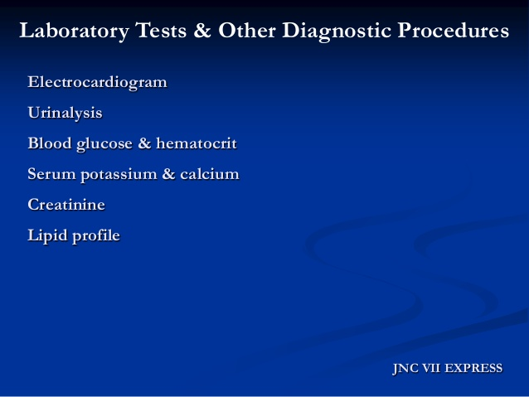

Slide 10
Evaluation for the presence of CKD
Markers of kidney damage include:
Serum creatinine and eGFR
proteinuria
Abnormalities of urine sediment
Abnormalities in imaging tests
Abnormalities of blood or urine composition specific for certain syndromes (as NS, renal tubular acidosis or others)

Slide 11
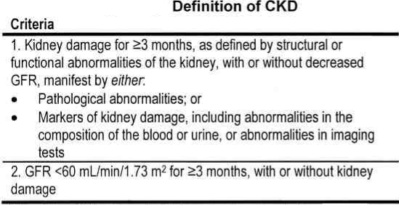

Slide 12
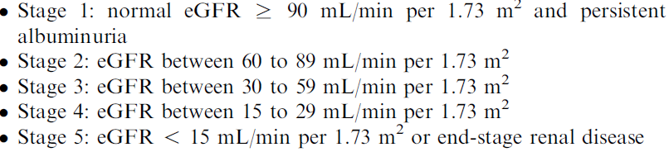
Stages of CKD

Slide 13
Evaluation of patients with HTN and CKD should include:
Stage of CKD
Cause of CKD
History of CKD : including history of and severity of CKD, duration and levels of HBP, evidence of CVD, presence of other comorbid conditions such as diabetes and dyslipidemia, lifestyle issues, medications
Physical examination : to assess severity of hypertension, presence of end-organ damage, and extracellular fluid volume or secondary causes of hypertension
Laboratory tests : estimate GFR from serum creatinine, albuminuria or proteinuria, urine analysis , electrolytes and imaging study

Slide 14

Goals of Antihypertensive Therapy in CKD

Slide 15
Goals of Antihypertensive Therapy in CKD
Treat to 140/90 mm Hg in patients with HTN & CKC (as for everybody else ) JNC 8
Benefits
Reduce the risk of CVD
Slow progression of kidney disease
Notes:
KDIGO 2012 recommend target BP to 130/80 mm Hg

Slide 16


Dietary and lifestyle modifications

Slide 17
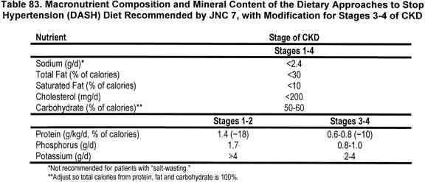
Dietary and lifestyle modifications
Dietary modifications

Slide 18
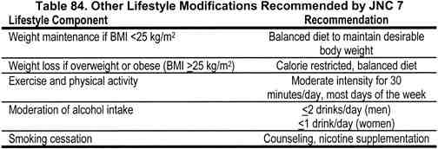

Slide 19
Kidney Disease Improving Global Outcome (KDIGO) guidelines as regard lifestyle modification
Achieving or maintaining a healthy weight (BMI 20 to 25).
Lowering salt intake to <90 mmol (< 2 g) per day of sodium (corresponding to 5 g of sodium chloride), unless contraindicated.
Undertaking an exercise program compatible with cardiovascular health and tolerance, aiming for at least 30 minutes 5 times per week.
Limiting alcohol intake to no more than two standard drinks per day for men and no more than one standard drink per day for women.

Slide 20

PHARMACOLOGICAL THERAPY

Slide 21
use of antihypertensive therapy in CKD General considerations
Patients with CKD should be considered in the "highest-risk" group for CVD for implementing recommendations for pharmacological therapy, irrespective of cause of CKD
Multidrug regimens will be necessary in most patients with CKD to achieve therapeutic goals, and Diuretics should be included in the antihypertensive regimen in most patients
Preferred agents for CKD should be used first and additional drugs should be prescribed on basis to prevent CVD

Slide 22
General considerations
The antihypertensive regimen should be simplified as much as possible
Long-acting (once-daily agents) should be used when possible
Two agents, either as separate prescriptions or as a fixed-dose combination containing preferred agents, may be considered as initial therapy for SBP >20 mm Hg above goal according to the stage of CKD and CVD risk
Fixed-dose combinations may be used for maintenance therapy after the antihypertensive regimen has been established

Slide 23
PHARMACOLOGICAL THERAPY
Nondiabetic kidney disease

Slide 24
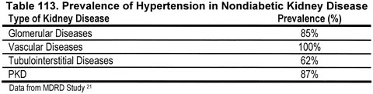
Nondiabetic kidney disease
Most patients with nondiabetic kidney disease are hypertensive

Slide 25
Nondiabetic kidney disease Choice of antihypertensive agent:
ACE inhibitors are more effective than other antihypertensive agents in slowing the progression of most nondiabetic kidney diseases
The beneficial effect is greater in patients with higher levels of proteinuria

Slide 26
Several large, randomized trials of participants with nondiabetic kidney disease determined that regimens including ACE inhibitors are more effective in reducing the occurrence of kidney endpoints compared to regimens not including ACE inhibitors

Slide 27
ACE Inhibition in Progressive Renal Disease (AIPRD) Study
Primary endpoints
Effects on blood pressure
Urinary protein excretion
Secondary endpoints
survival without kidney failure
1,860 nondiabetic patients enrolled in 11 RCTs of various ACE inhibitors
Results: ACE inhibitor group had better blood pressure control, lower urine protein excretion, and an approximately 30% reduction in the risk of kidney failure, as well as a reduction in the combined endpoint of doubling of serum creatinine or onset of kidney failure.

Slide 28
Ramipril Efficacy in Nephropathy (REIN) Study
It is randomised placebo-controlled trial of effect of ramipril on decline in glomerular filtration rate and risk of terminal renal failure in proteinuric, non-diabetic nephropathy
Conducted on 352 patients
Interpretation :ramipril safely reduces proteinuria and the rate of GFR decline to an extent that seems to exceed the reduction expected for the degree of blood-pressure lowering and also showed a beneficial effect on ACE inhibitors in reducing the incidence of kidney failure.

Slide 29
Nondiabetic kidney disease Additional antihypertensive agent
Diuretics may potentiate the beneficial effects of ACE inhibitors and ARBs in nondiabetic kidney disease
ACE inhibitors, ARBs, and nondihydropyridine calcium-channel blockers have a greater antiproteinuric effect than other antihypertensive classes in nondiabetic kidney disease.

Slide 30
PHARMACOLOGICAL THERAPY
Diabetic kidney disease

Slide 31
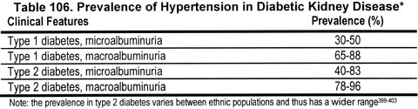
Diabetic kidney disease
Most patients with diabetic kidney disease are hypertensive

Slide 32
Diabetic kidney disease Choice of antihypertensive agent:
Patients with diabetic kidney disease, with or without hypertension, should be treated with an ACE inhibitor or an ARB
ACE inhibitors and ARBs are effective in slowing the progression of kidney disease with microalbuminuria due to type 1 and type 2 diabetes
Multiple antihypertensive agents are usually required to reach target blood pressure

Slide 33
Collaborative Study Group (CSG) trial of Captopril in Diabetic : showed that ACE inhibitors are more effective than other antihypertensive classes in slowing the progression of kidney disease with macro -albuminuria due to type 1 diabetes
Irbesartan Diabetic Nephropathy Trial (IDNT) & Reduction of endpoints in NIDDM with the angiotensin II antagonist losartan (RENAAL) study : showed that ARBs are more effective than other antihypertensive classes in slowing the progression of kidney disease with macroalbuminuria due to type 2 diabetes

Slide 34
Additional antihypertensive agent to reduce CVD risk and reach target BP level
As multiple antihypertensive agents are usually required to reach target blood pressure following drugs could be added:
Diuretics (preferred)
Beta blockers
Calcium channel blockers
Don't use an ACE inhibitor and ARB in combination

Slide 35
ACE inhibitor and ARB in CKD

Slide 36
ACE inhibitor and ARB in CKD
ACE inhibitors and ARBs can be used safely in most patients with CKD
ACE inhibitors and ARBs should be used at moderate to high doses, as used in clinical trials
ACE inhibitors and ARBs should be used as alternatives to each other, if the preferred class cannot be used
ACE inhibitors and ARBs not used in combination to lower blood pressure or reduce proteinuria

Slide 37
ACE inhibitor and ARB in CKD (serum potassium )
ACE inhibitor and ARB may cause hyperkalaemia
Avoid other medications that cause hyperkalaemia (potassium supplements, NSAIDs, Cox 2 inhibitors, potassium- sparing diuretics)
Evaluate cause of hyperkalaemia
treat hyperkalaemia with diuretics
Continue ACE inhibitor or ARB if ≤ 5.5 mE∕L
Diuretics may cause hypokalaemia
Evaluate causes of hypokalaemia
Treat hypokalaemia with caution in CKD

Slide 38
ACE inhibitor and ARB in CKD (GFR)
If GFR decline by >30% from base line within 4 weeks, evaluate causes
Continue ACE inhibitor or ARB if GFR decline <3o% from base line value over 4 months

Slide 39
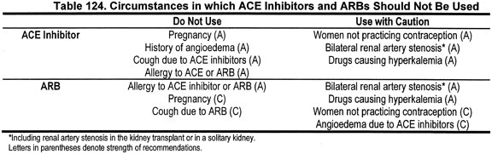

Slide 40
USE OF DIURETICS IN CKD

Slide 41
USE OF DIURETICS IN CKD
Diuretics reduce ECF volume, lower blood pressure, potentiate the effects of ACE inhibitors, ARBs, and other antihypertensive agents, and reduce the risk of CVD in CKD.
Choice of diuretic agents depends on the level of GFR and need for reduction in ECF volume.
Thiazide diuretics given once daily are recommended in patients with GFR ≥30 mL/min/1.73 m² (CKD Stages 1-3)
Loop diuretics given once or twice daily are recommended in patients with GFR <30 mL/min/1.73 m² (CKD Stages 4-5)
Loop diuretics given once or twice daily, in combination with thiazide diuretics, can be used for patients with ECF volume expansion and edema

Slide 42
USE OF DIURETICS IN CKD
Potassium-sparing diuretics should be used with caution:
In patients with GFR <30 mL/min/1.73 m² (CKD Stages 4-5)
In patients receiving concomitant therapy with ACE inhibitors or ARBs
In patients with additional risk factors for hyperkalemia
Patients treated with diuretics should be monitored for:
Volume depletion, manifest by hypotension or decreased GFR
Hypokalemia and other electrolyte abnormalities
The interval for monitoring depends on baseline values for blood pressure, GFR and serum potassium concentration

Slide 43
PHARMACOLOGICAL THERAPY
kidney transplant recipients

Slide 44
Kidney disease in kidney transplant recipients
Most kidney transplant recipients have CKD and hypertension.
High blood pressure in kidney transplant recipients is a risk factor for faster progression of CKD and development of CVD.
Patients with CKD in the kidney transplant should be treated with any of the following to reach the target blood pressure: CCB, diuretics, ACE inhibitor, ARB, or beta-blocker

Slide 45

Blood pressure management in elderly persons with CKD

Slide 46
Blood pressure management in elderly persons with CKD
In population health surveys, a large proportion of the elderly have a reduced GFR and elevated blood pressure
Tailor BP treatment regimens in elderly patients with CKD by carefully considering age, attention to adverse events related to BP treatment, including electrolyte disorders, acute deterioration in kidney function, orthostatic hypotension and drug side effects co-morbidities and other therapies.

Slide 47
Home message
CKD & HTN are closely related to each others and significantly increasing the CVD
Target BP should be to 140/90 mm Hg
ACE inhibitors and ARBs are effective in slowing the progression of kidney disease in hypertensive and CKD patient
Careful monitoring to serum potassuim, GFR and extracellular fluid volume.
Special attention should be given to the elderly with CKD.

Slide 48
Thank you for your attention

